Slide 1
Handling Big Data with Python
Dr. Florian Wilhelm
PyCon 2013, October 17th

Slide 2
What is Big Data?
Blue Yonder‘s definition:
Big data is the art of extracting new insights and new forms of value from data at a large scale in the way that it causes a disruptive change in a domain.
From „Big Data“, Viktor Mayer-Schönberger and Kenneth Cukier:
„At its core, big data is about prediction.”

Slide 3
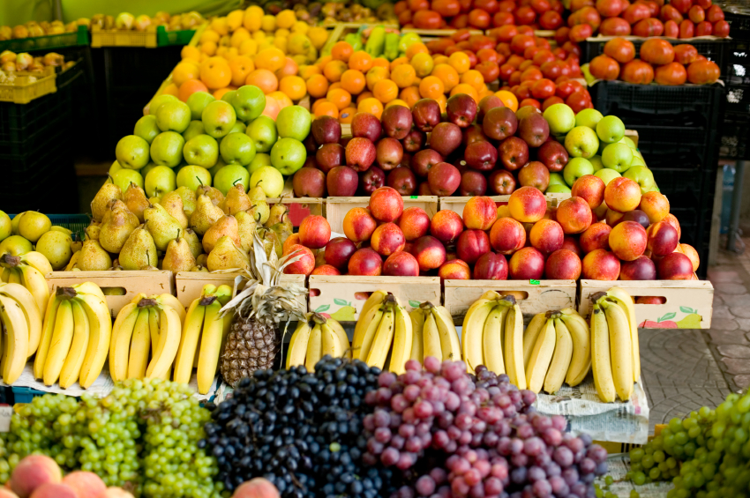
What does the future hold?
What would happen if...
... a large supermarket chain knew precisely how much fresh fruit it will sell?

Slide 4
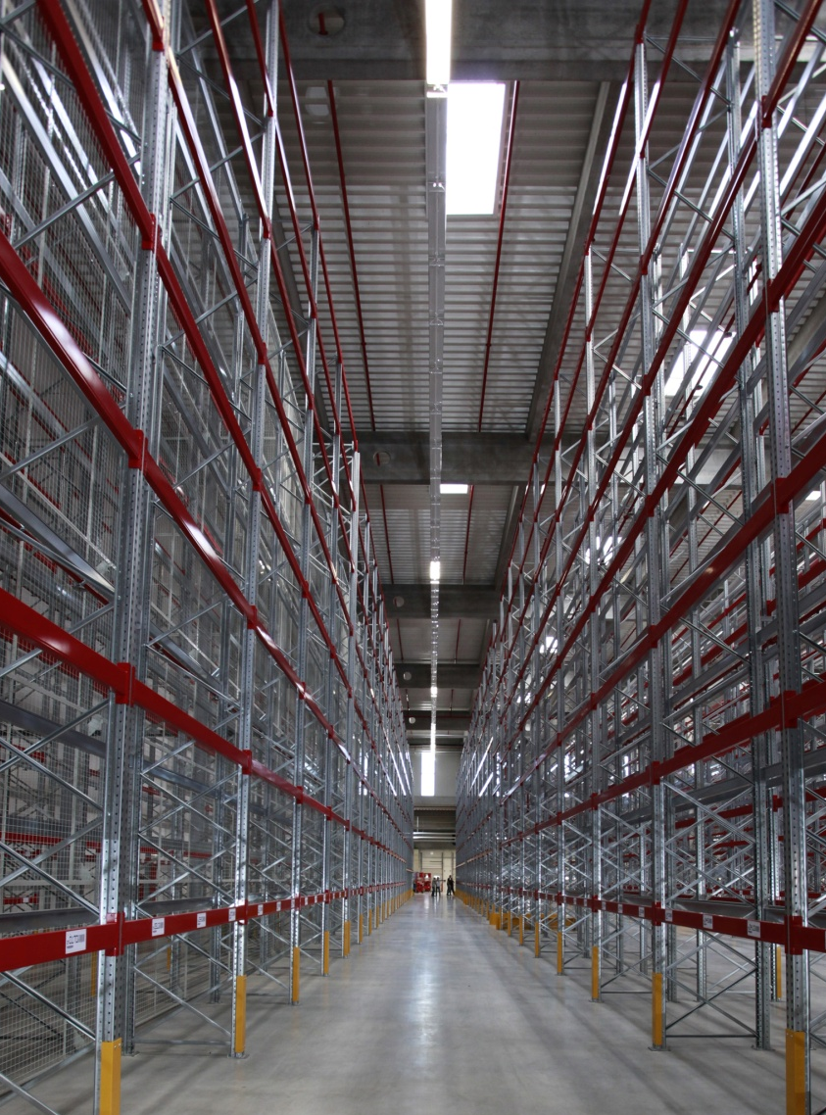
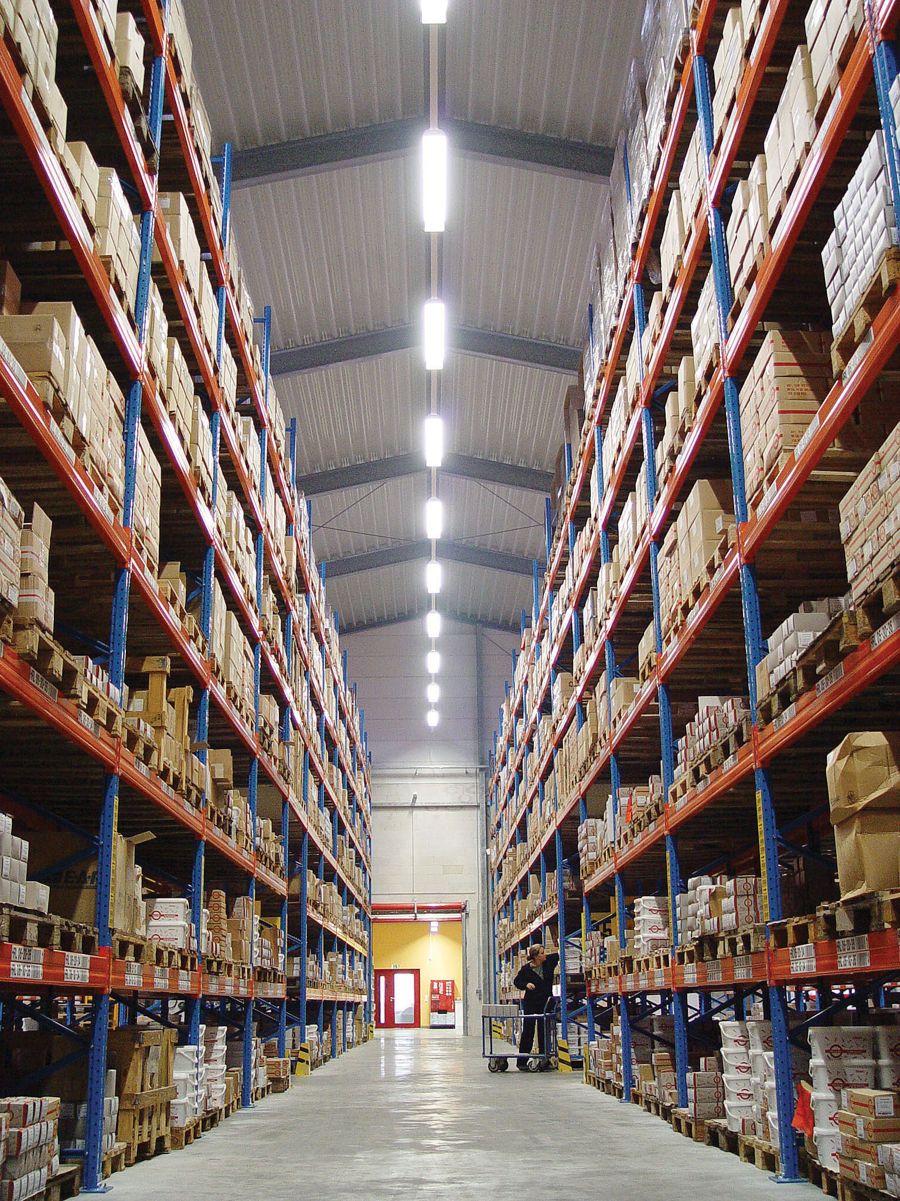
What does the future hold?
What would happen if...
... a producer or retailer had precisely the goods in stock that it actually will need?

Slide 5

What does the future hold?
What would happen if...
... fashion was never out of stock?

Slide 6

What does the future hold?
What would happen if...
... energy providers knew how high energy consumption was at what time of day?

Slide 7


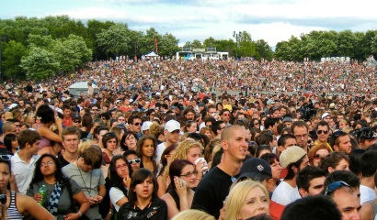

Predictive Analytics allows insights about individual probabilities for real systems
e.g. attendance and sales
Pendulum
(deterministic)
100%
Lottery
(pure chance)
Individual predictability
0%

Slide 8
We provide predictions
Data Mining and conventional Business Intelligence
Predictive & Prescriptive Analytics
WHY?
WHAT WILL HAPPEN?
WHAT HAS HAPPENED?
PATTERN
PATTERN PREDICTIONS
DATA
Influence on business performance

Slide 9

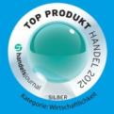



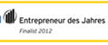


Blue Yonder Science Meets Business
Top Retail
Product 2011/2012
Retail Technology Award 2012
Winner Data Mining Cup 2009 & 2010
bwcon Hightech Award
Special Award
Deutsche Börse
2012
Finalist
Entrepreneur of the Year 2012
FOCUS
Digital star
2013
Founded in 2008 by scientists in the world’s largest research facility and “data science factory” CERN, we have been doing Big Data since before Big Data was cool
A unique Predictive Analytics Software for the industry´s most precise predictions
Superior statistical algorithms and machine learning capabilities
World-class talent: > 100 employees, 50 Ph.D. data scientists

Slide 10
We are unique
Optimal Order Volume
Porpability Density
E(X)
BlueYonder Technology
Has its origin in experimental particle physics
Developed and matured over 400 Dev-Years
100
120
Turnover
1 PETA – BYTE / SEC
Processes huge data volumes highly efficient

Slide 11

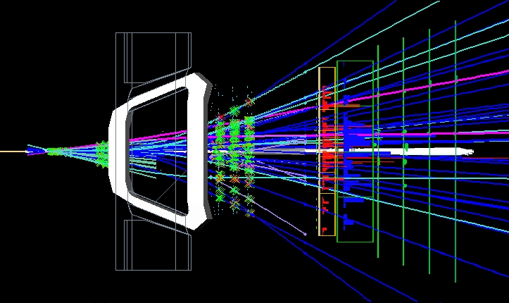
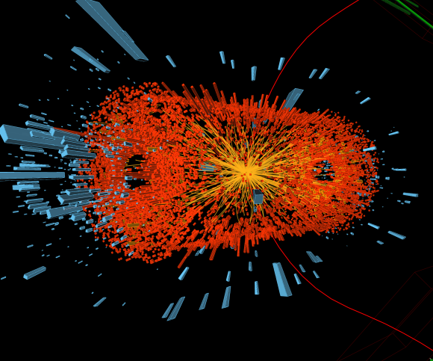
Our Background: High Energy Physics Fundamental research at the forefront of science
At the LHC (CERN) - per Experiment:
40 MHz collision rate
Leads to about 1 PB of data stored per year.
LHCb:
30 000 instances of NeuroBayes running 24/7 to filter out the „interesting“ events in real-time.
It‘s like searching for the needle in the hay stack… but you don’t get to keep said hay stack for your search.
Photo: CERN

Slide 12

Blue Yonder‘s Road to Python
The good, old days:
Usage of NeuroBayes with a FORTRAN interface and a C++ wrapper…
… as well as some shell code
DanaliNPS, „MountMcKinley“, 12/27/2010, Creative Commons License
Notes:
2000 Fortran Code + Program
Train/Predict getrennt (mehrere Prozesse)
Shell betrieb (liest von CSV)
C++ Wrapper für Fortran, mehrere Experten gleichzeitig.

Slide 13

Stream-based Approach
Luckily all samples in particle physics are independently distributed…
Rachel_thecat, „Stream of light, stream and water“, 08/22/2008, Creative Commons License

Slide 14
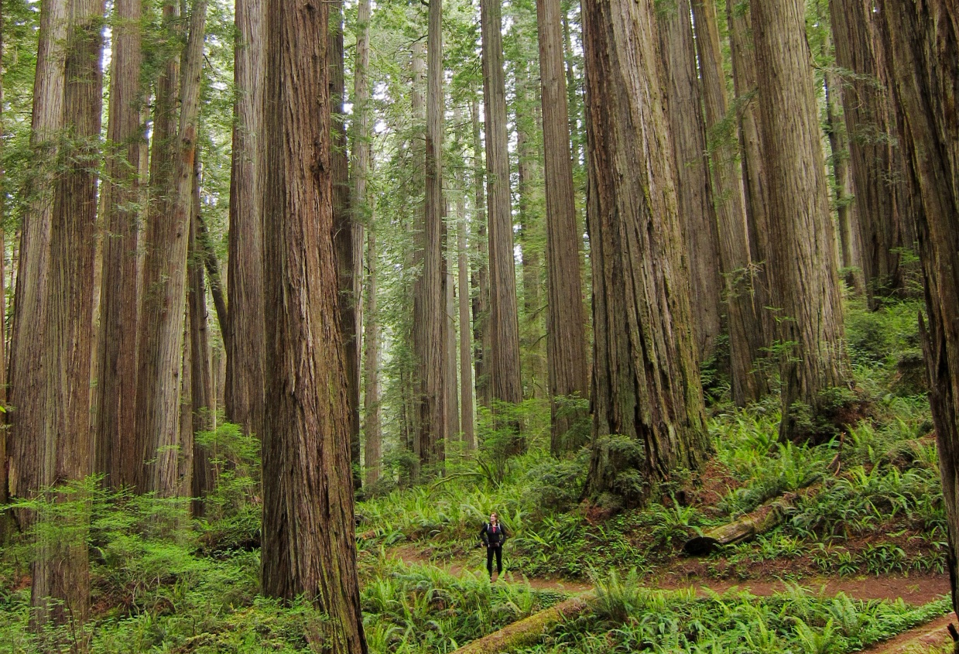
But it got better…
… with our own FORTRAN/C++
code generator and CSV files
Miguel Vieira, „Hiker and redwoods…“, 05/29/2012, Creative Commons License
Notes:
Codegen 1 (Teilchenphysik, samples total unabhängig)
ASCII Dateien zur Konfiguration
Generiert c++/fortran code
Aggregationen mit SQL oder shell commands
Zum wegfiltern von Backgroundsignal in der Teilchenphysik

Slide 15
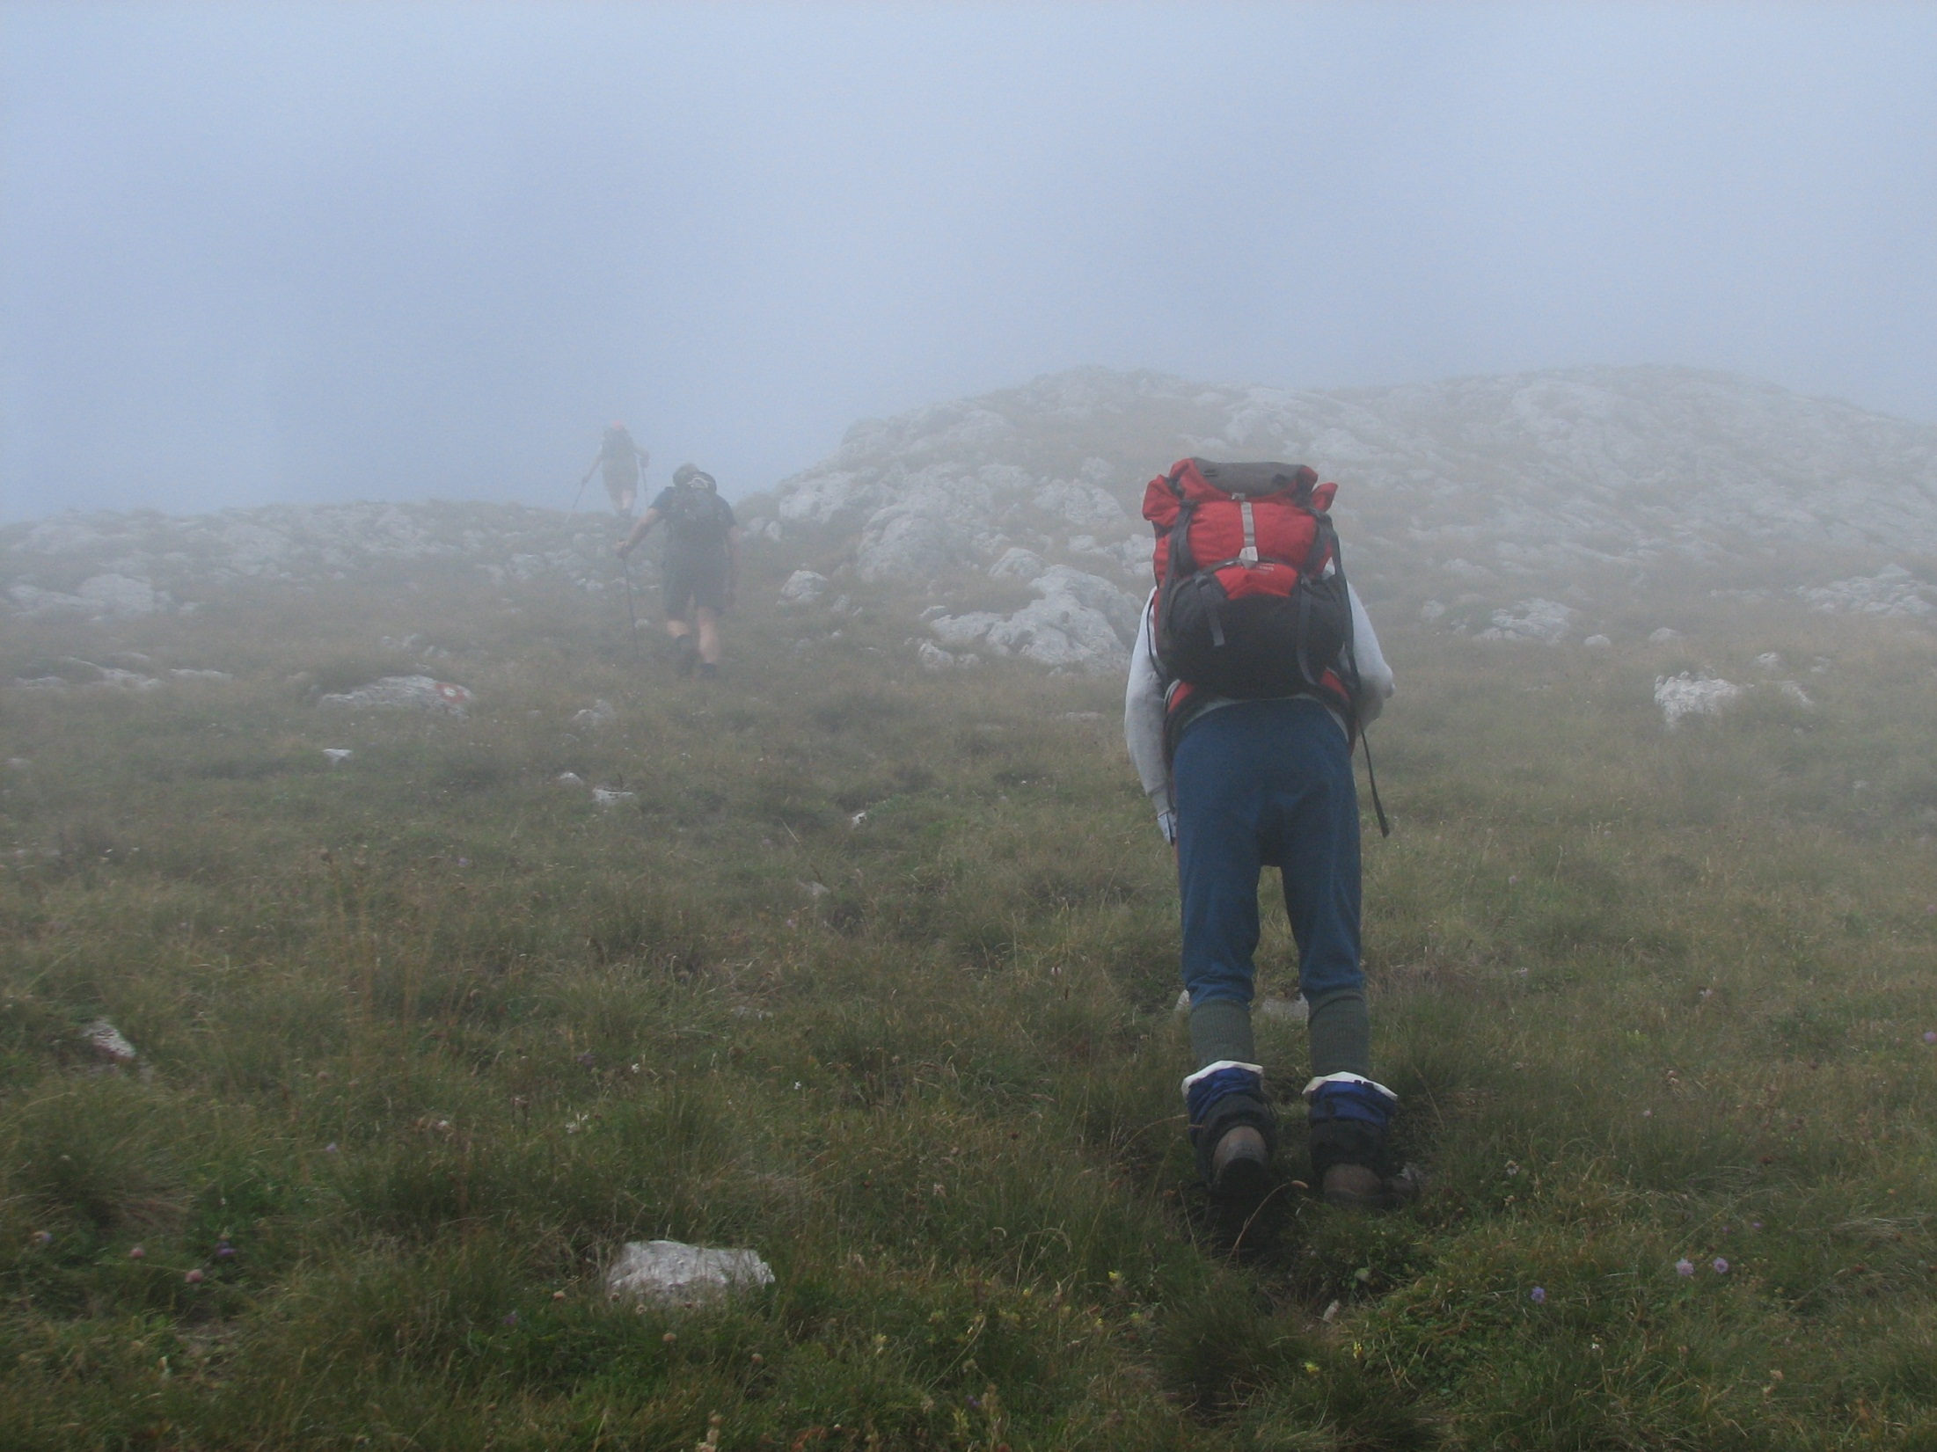
Pipeline based C/C++ Interface
Transition towards a library that abstracts data sources (DB, CSV, etc.)
NH53, „Approaching the plateau below the summit“, 09/04/2009, Creative Commons License
Notes:
DSA für Zeitreihen, erste kommerzielle Anwendungen Aggregation, Durschnitt (Data Plumbing)
Pipeline/Ansatz über Iteratoren
C Sprach auch C++ dann über Techteam, ranges
Stack/Unstack exp moving average
Alles ein Programm
Weg von Codegen hin zu einer Bibliothek
Streambasiert
Unabhängig vom Import (CSV, DB etc.)

Slide 16

… and finally a Python Interface
Implemention as extension of SciKit-Learn
Kitty Terwolbeck, „Looking over the ice sheet“, 10/11/2011, Creative Commons License
Notes:
NBPy (Sept 2012)
Benötigt viel Speicher (nicht stream-basiert)
Cython für Performance
Relativ schnell Migration ab Nov 2012
Scikit-Learn Ecosystem und gutes Design, Metaestimators
Fortran Neurobayes Code als Estimator in Scikit-Learn
Easy to use, great flexibiity
Easy deployment with pip/virtual env etc.

Slide 17
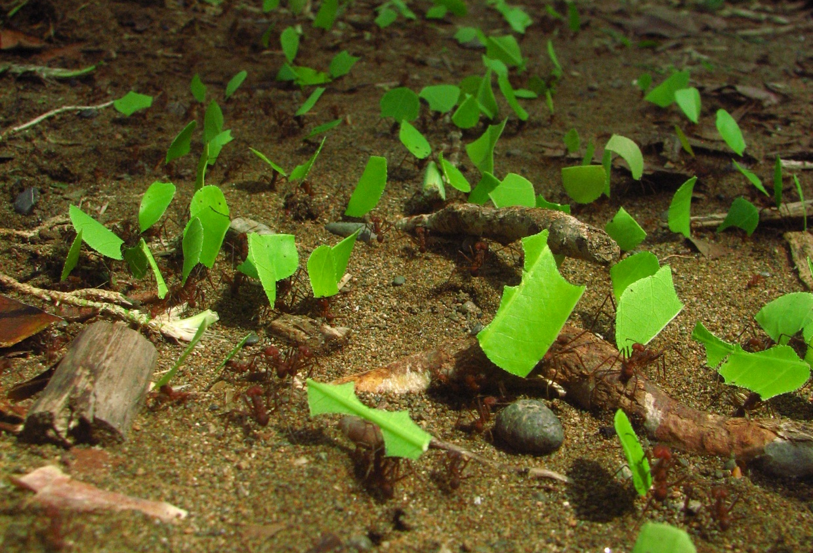
Parallelization of Python Jobs
Requirements:
Scalable to handle Big Data problems
Easy to use framework for Data Scientists
Possible mixing of C++ and Python tasks
Clean separation of computation and data retrieval (on a programming level, not physical)
Easy transition from development to a productive deployment
Prioritized multi-tenants in BY cloud service for SLA compliance
Bandwagonman, „Leafcutter ants transporting leaves“, 13/01/2008, GNU Free Documentation License

Slide 18
Application Server Architecture
Python Job
Controller
IO
defines
Data
Handles
IO
Python Job
Access
Architecture:
Application of SPMD paradigm
Separation of data and computation through data handles
Python/C++ jobs are unit testable
Jobs are sandboxed inside „worker“ processes
AppServer‘s responsibility:
Data Store Access (ODBC, etc…)
Conversion of Python data types
IO
C++ Job
Data Store
(DB, FS, HBASE …)

Slide 19
Dependency Graph of Scheduled Jobs
Scheduled jobs build a DAG:
Applying the „future, promise, delay“ pattern
Chaining C++ and Python jobs: output of one as the input of another
AppServer Scheduler‘s responsibilty:
Monitoring the status of each job (running/waiting/failed)
Restarting failed jobs
Prioritizing each job with respect to available resources
Controller
defines

Slide 20
Python Developer Perspective
Server
Python Job
Controller
Workers
C++ Job
Python Job
User uploads Python/C++ project code to the BY cloud service
„Self-aware“ cloud service, i.e. self-reflective, self-predictive, self-adaptive
Easy to use parallelization framework
Effective usage of resources and isolation between uploaded projects
Easy transition from development to production
Notes:
http://descartes.ipd.kit.edu/research/vision/

Slide 21
Summary
Python
is well-suited for modelling (rapid prototyping and productive code)
provides a rich ecosystem (Numpy, Scikit-learn) for data science
is a good neighbour (easy interfacing with C and Fortran code)
is used at Blue Yonder to handle Big Data with the help of an application server framework

Slide 22
Thanks
for your attention!

Slide 23
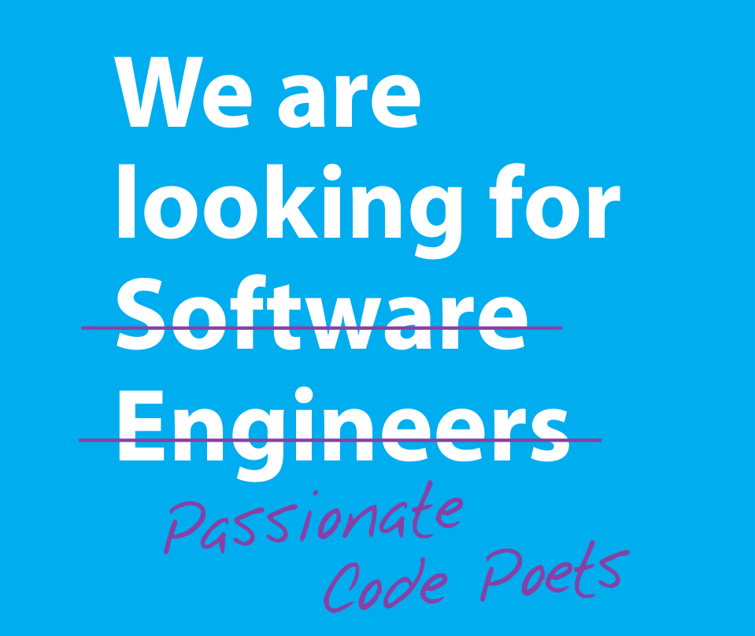
Check out our Career Opportunities on
http://www.blue-yonder.com/

Slide 24

Tipps und Tricks Ihre neuen Textebenen
Im Master sind verschiedene Textformatierungen bereits angelegt, das erleichtert Ihnen das Arbeiten und sorgt für ein einheitliches Aussehen der Schrift. Fließtext (erste Textebene), Arial 16pt
Hervorgehobener Text (zweite Textebene) Arial, 16pt, bold
Bullet point Text I (dritte Textebene) Arial, 16pt
Bullet point Text II (vierte Textebene) Arial, 16pt
Fließtext (fünfte Textebene) Arial, 14pt
Hervorgehobener Text (sechste Textebene) Arial, 14pt
Bullet point Text I (siebte Textebene) Arial, 14pt
Bullet point Text II (achte Textebene) Arial, 14pt
Highlight Text (neunte Textebene) Arial, 16pt, fett
Um die Textebenen zu nutzen, verwenden Sie die „Einzug vergrößern“ oder „Einzug verkleinern“ Schaltflächen in der Symbolleiste oder Ihre Tastatur: ALT+Shift+Links oder Rechts

Slide 25
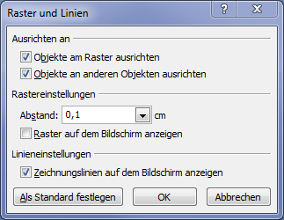
Raster Ihre neues Raster
Um die Hilfslinien zu aktivieren, machen Sie einen Rechtsklick neben der Folie und im folgenden Feld:

